Slide 1
EquiNaM
Who participates? Socio-demographic and socio-economic differences in a women’s group intervention to improve maternal and newborn survival
Dr Joanna Morrison, Dr Tanja Houweling & EquiNaM team http://equinam.global-health-inequalities.info
Introduction:
Progress towards Millennium Development Goals has been highly uneven.
Lower socio-economic groups lag behind
Inequalities in maternal and child health are huge - between and within countries

Slide 2
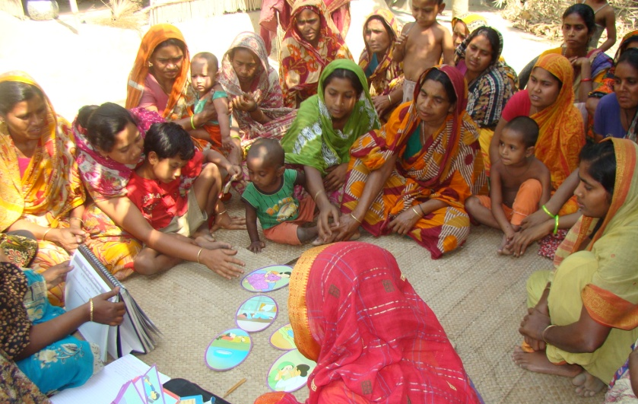
Our research
Effective interventions are known, but rarely reach those who need them most.
7 cluster RCTs of women’s group interventions working through participatory learning and action cycles in India, Nepal, Bangladesh, Malawi
37% reduction in maternal mortality and 23% reduction in neonatal mortality (Prost et al. Lancet 2013)
Problem Identification
Participatory evaluation
Planning together
Implementation

Slide 3
Methods
Quantitative and qualitative research to understand:
1. What were the socio-demographic and socio-economic differences in attendance in women’s groups?
Secondary analysis of trial data
Combined population > 2 million
Prospective surveillance of birth outcomes through post-partum interview
2. Where there were differences, why was this the case, and how can these be changed?
Purposive sampling of women attending/not attending groups, focus group discussions and SSI

Slide 4
Quantitative findings
-In all trials small/no socio-economic
differences in women attending
groups compared with
population
some sites: lower attendance
among elite (top 2-10%)
In all trials young, married women
with no children attended
less
Not just in South Asia, also in
Malawi

Slide 5
Qualitative findings
Why were there no/small socioeconomic differences between attenders and the population?
The facilitator was respected and encouraged ALL women.
The materials were easy to understand and fun
Maternal and newborn health issues affect everyone, not just rich or poor women, so everyone was interested to learn
Why did young married women with no children attend less?
”As she is just married, she is new in the community. She is under the control of her father and mother-in-law, as well as her husband... also, because of shyness and fear newly married girls don’t come to the group.” (Nepal Dhanusha FGD)
“I do say I want to go. But they say, ‘it’s too far away’. And I’m a new bride. People will say bad things about me if I go”(young married woman Bangladesh FGD)
How to overcome barriers to attendance?
Home visits to talk to families and encourage women; split group into two:
“Maybe the women need to be split into two groups; the old women in their own group and those with no children in another group.” (Malawi FGD)

